Slide 1



SMART INDIA HACKATHON 2026
TITLE PAGE
  Problem Statement ID – 26006
  Problem Statement Title- Development of an Intelligent Freight Forecasting Model for Optimized Vessel Chartering and Bulk Cargo Procurement from overseas to East Coast of India
  Theme- Transportation & Logistics
  PS Category- Software
  Team ID- 157830
  Team Name- CargoNex

Slide 2
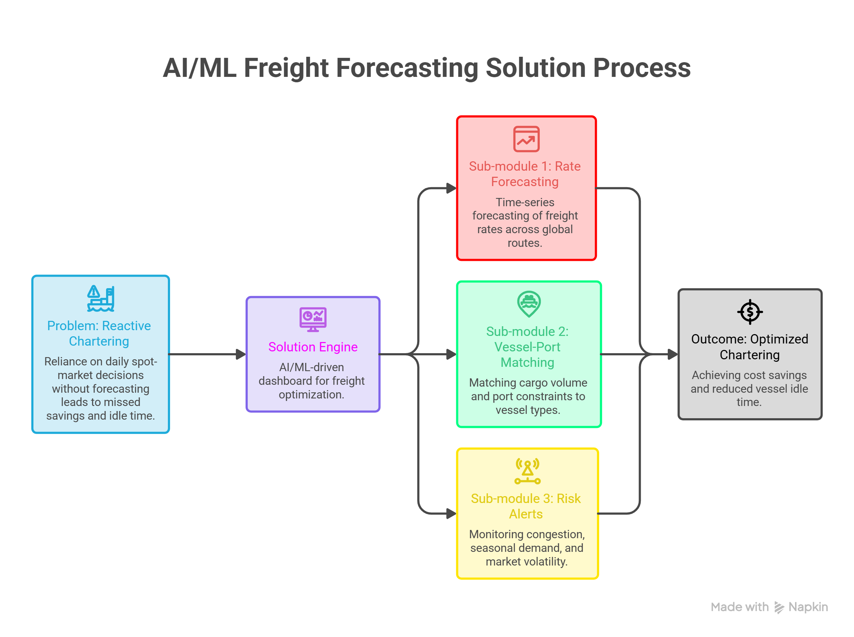
IDEA TITLE
CargoNex
@SIH Idea submission- Template
2
Notes:
2

Slide 3
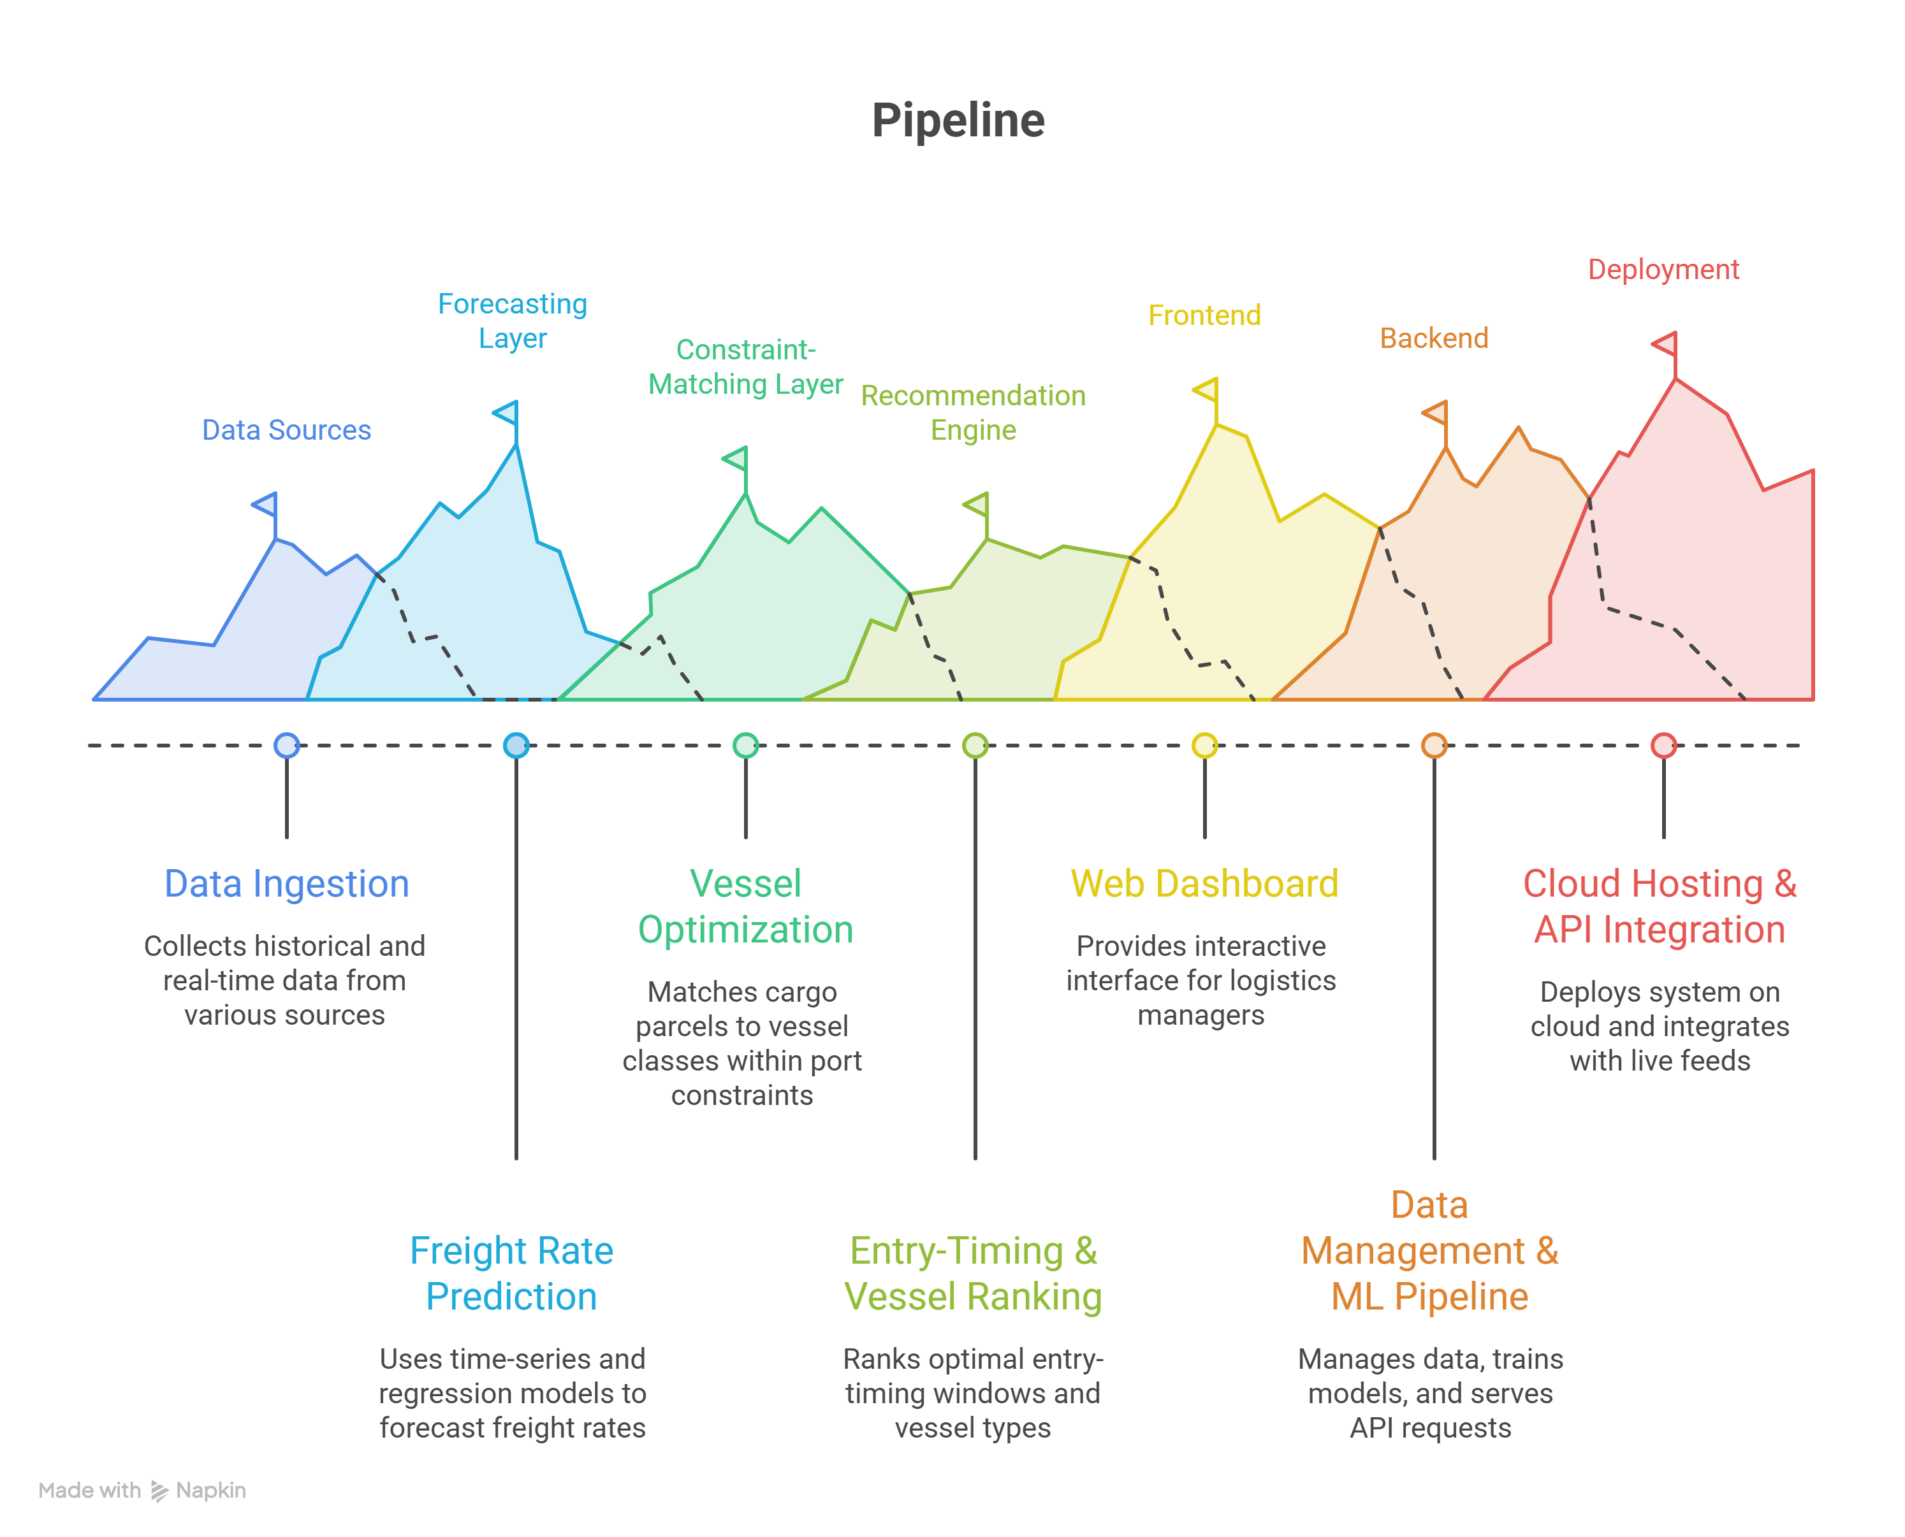
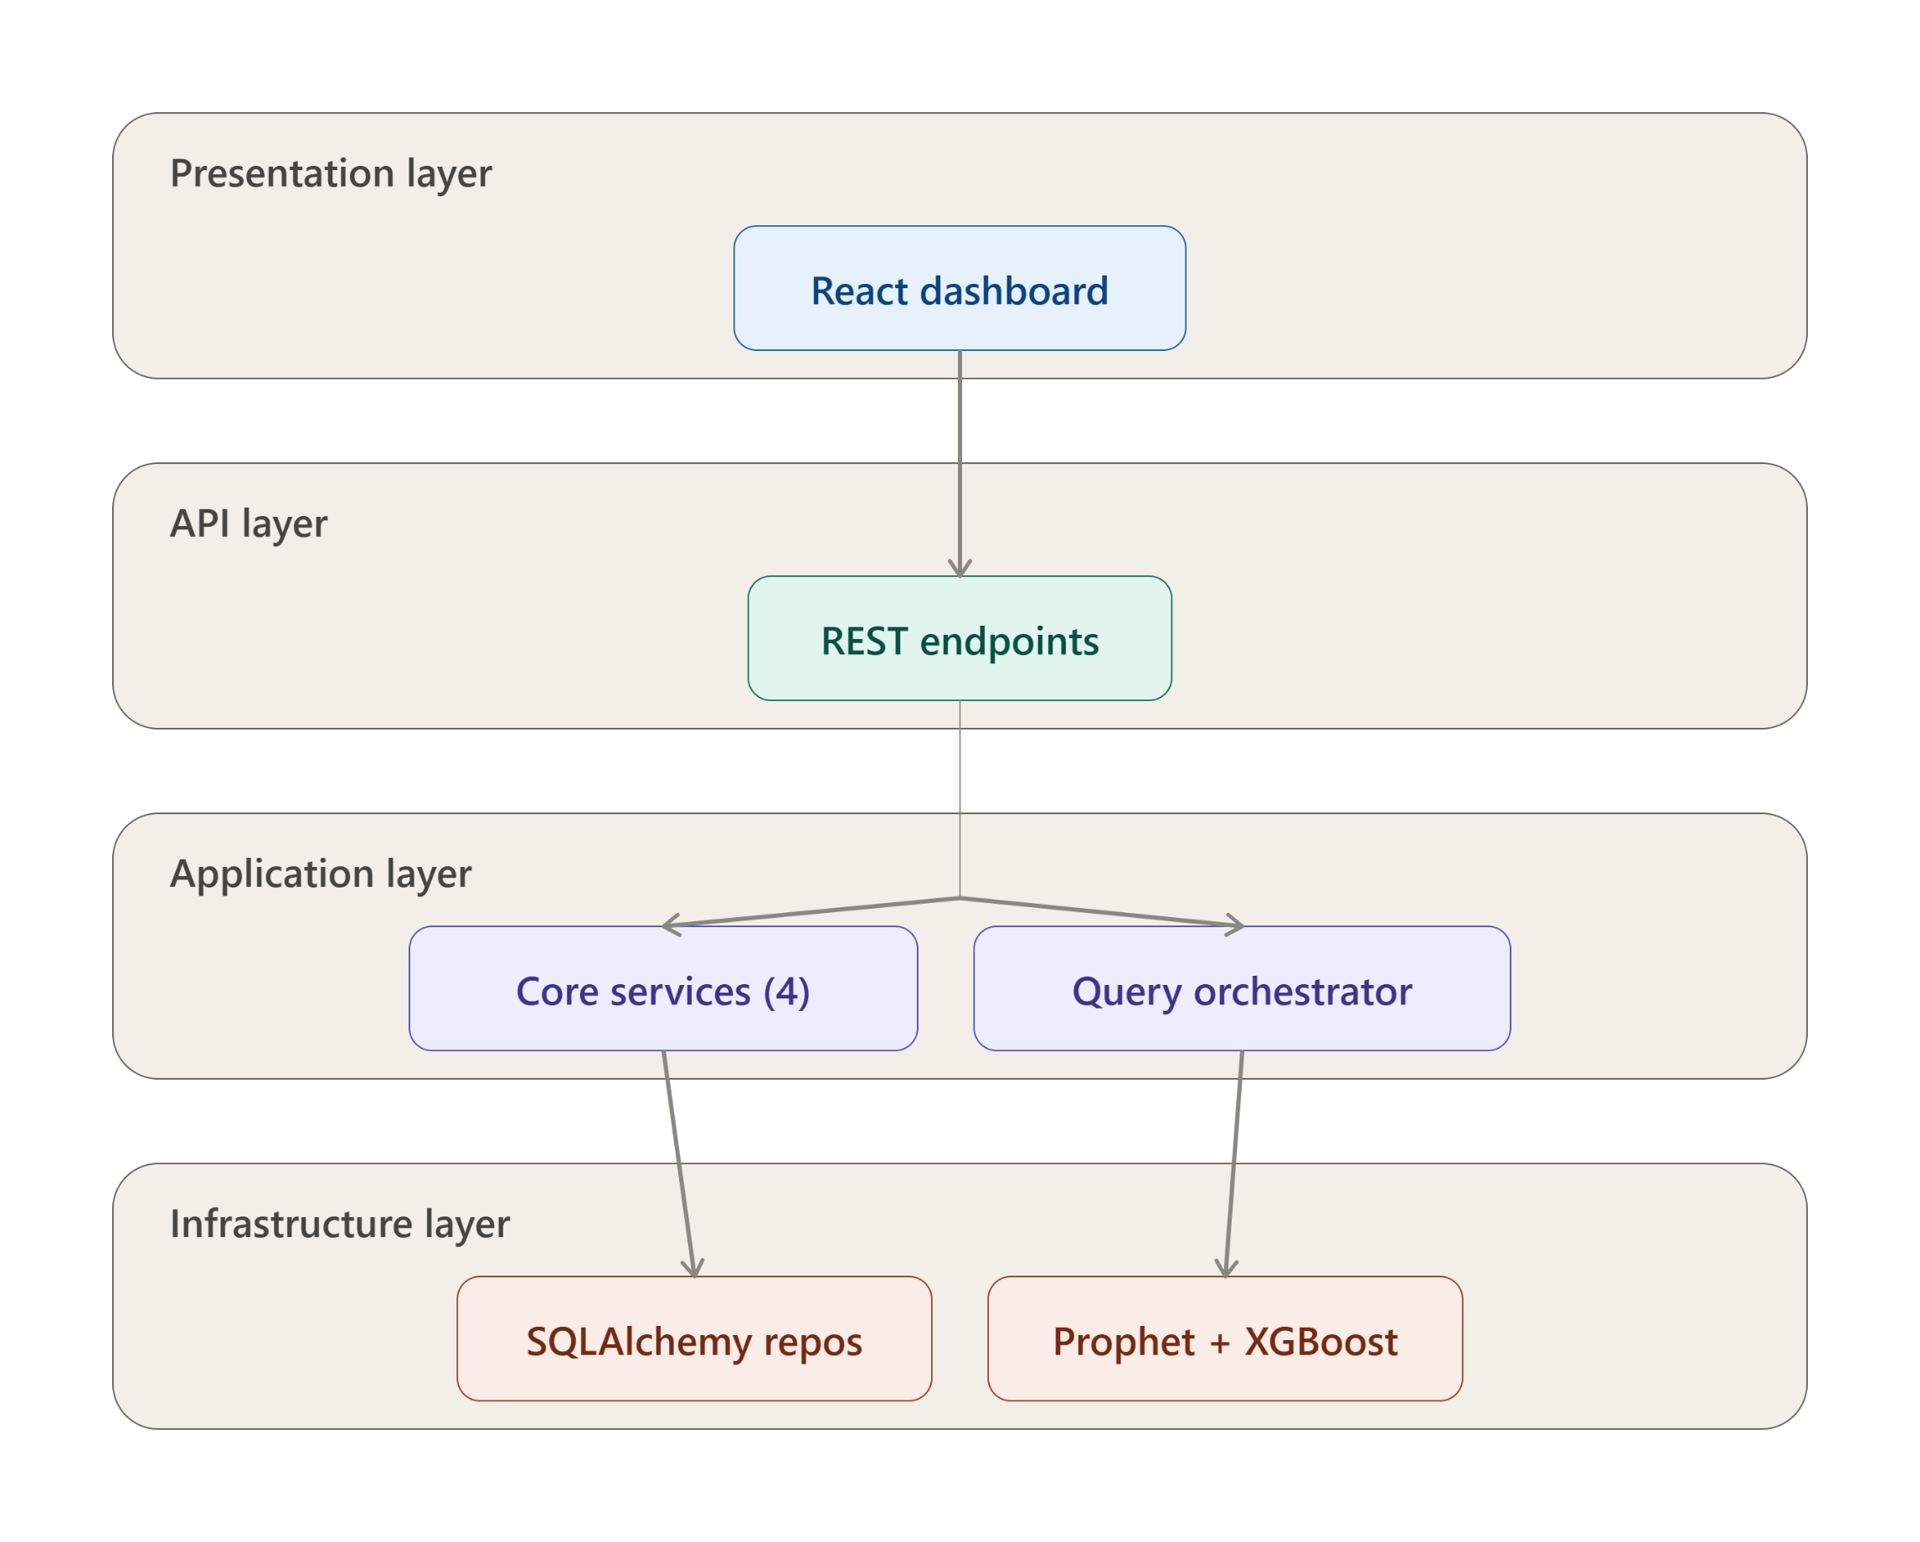
TECHNICAL APPROACH
CargoNex
@SIH Idea submission- Template
3
Notes:
3

Slide 4
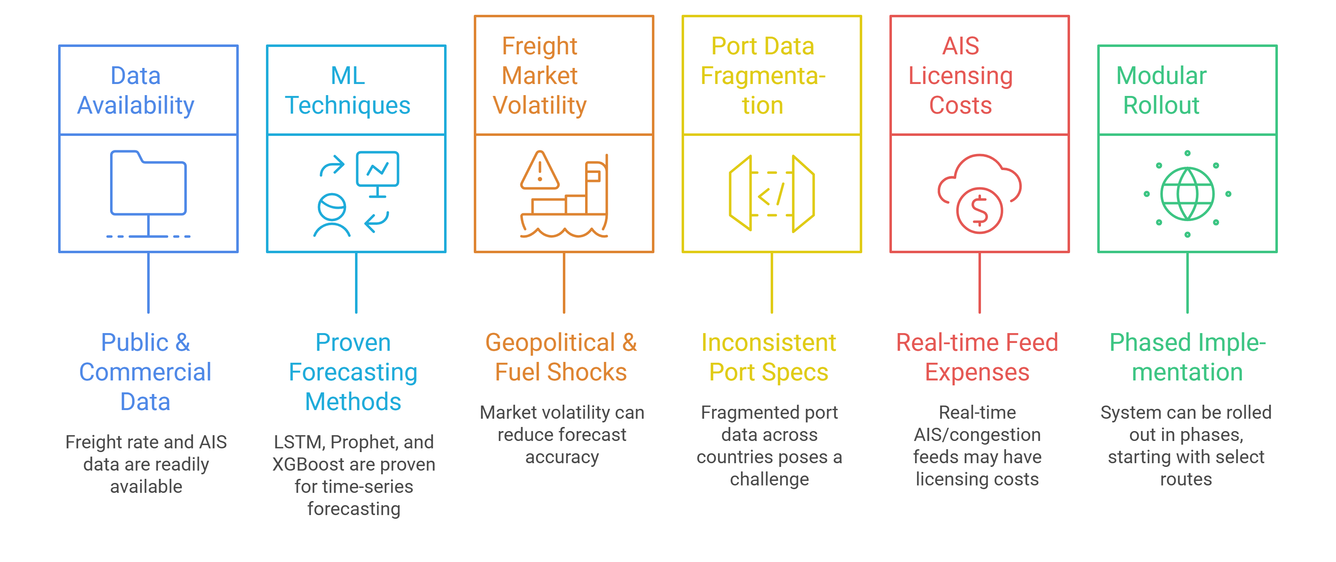
FEASIBILITY AND VIABILITY
CargoNex
@SIH Idea submission- Template
4
Notes:
4

Slide 5
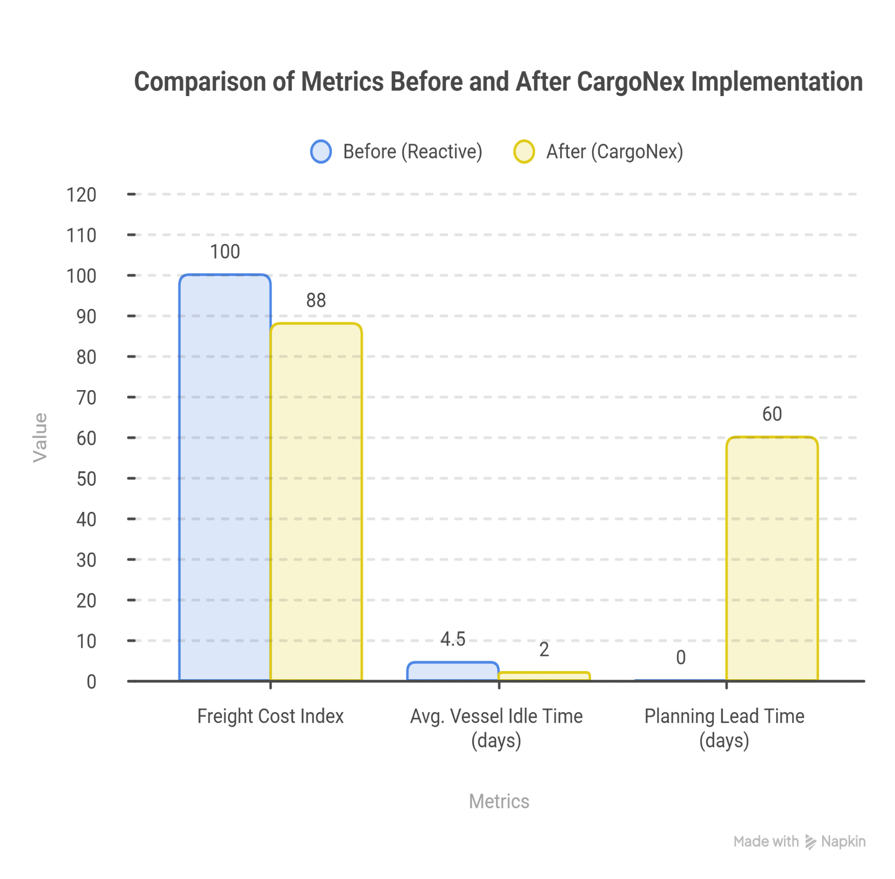
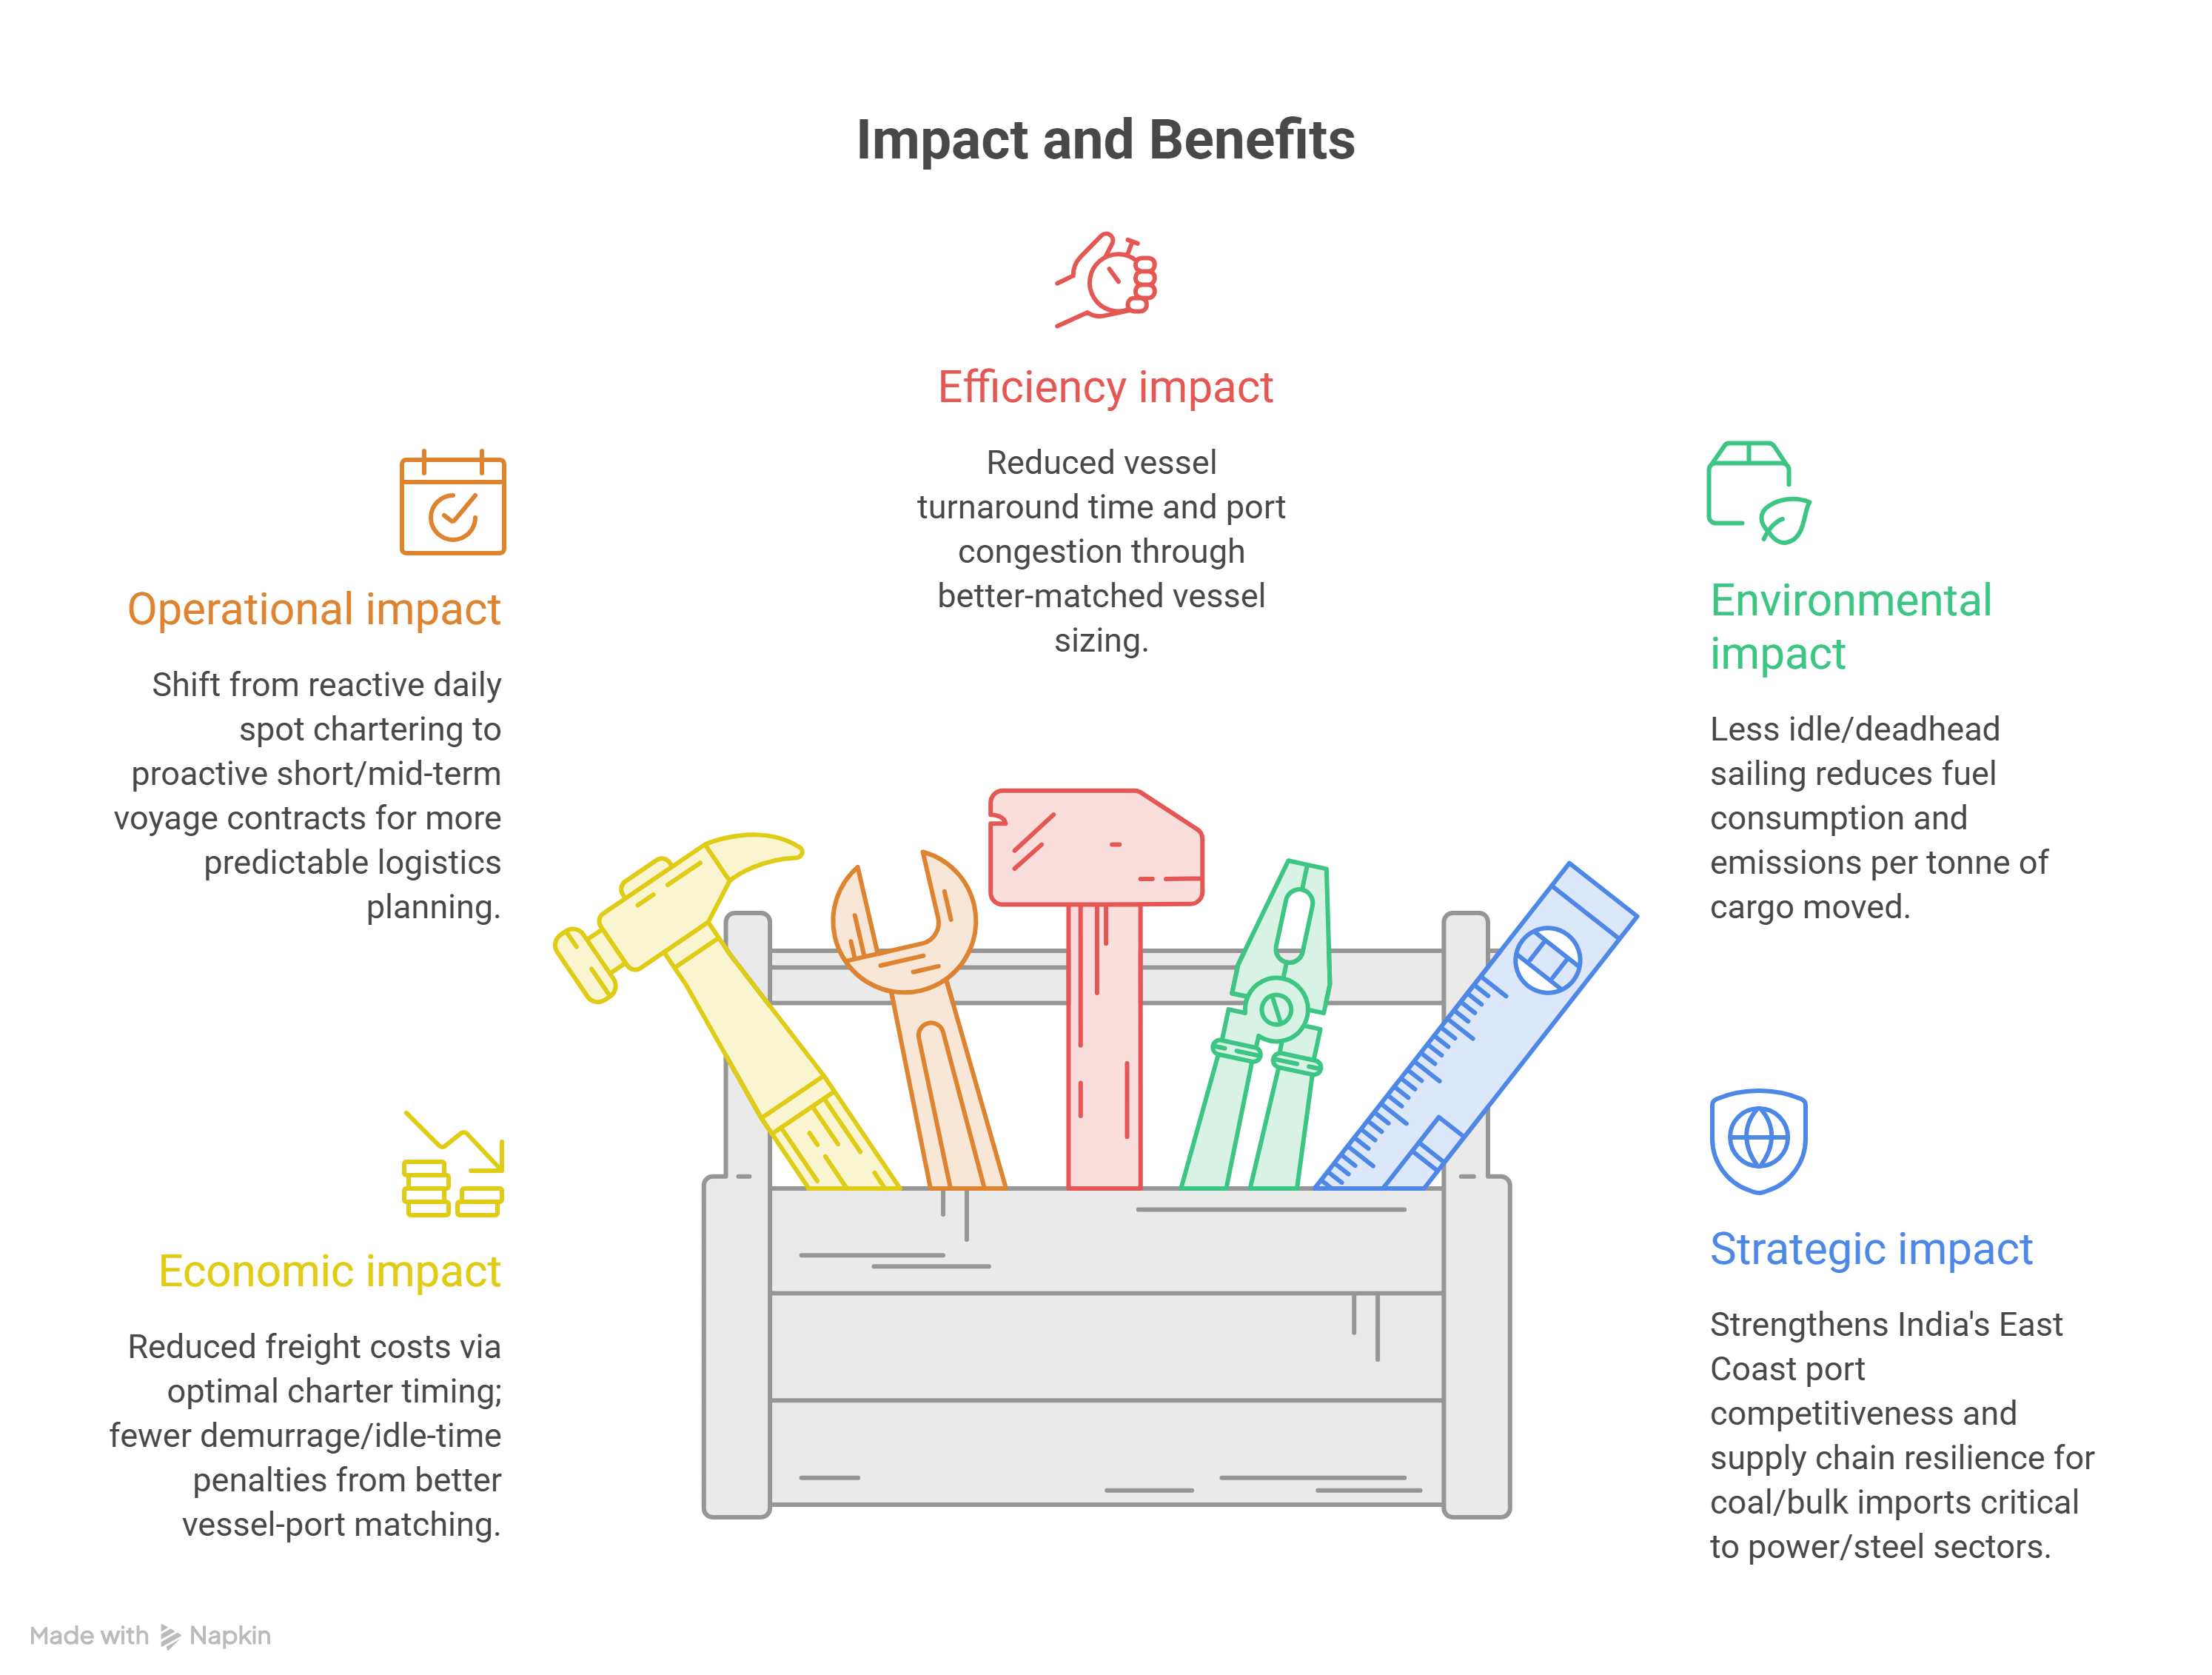
IMPACT AND BENEFITS
CargoNex
@SIH Idea submission- Template
5
Notes:
5

Slide 6
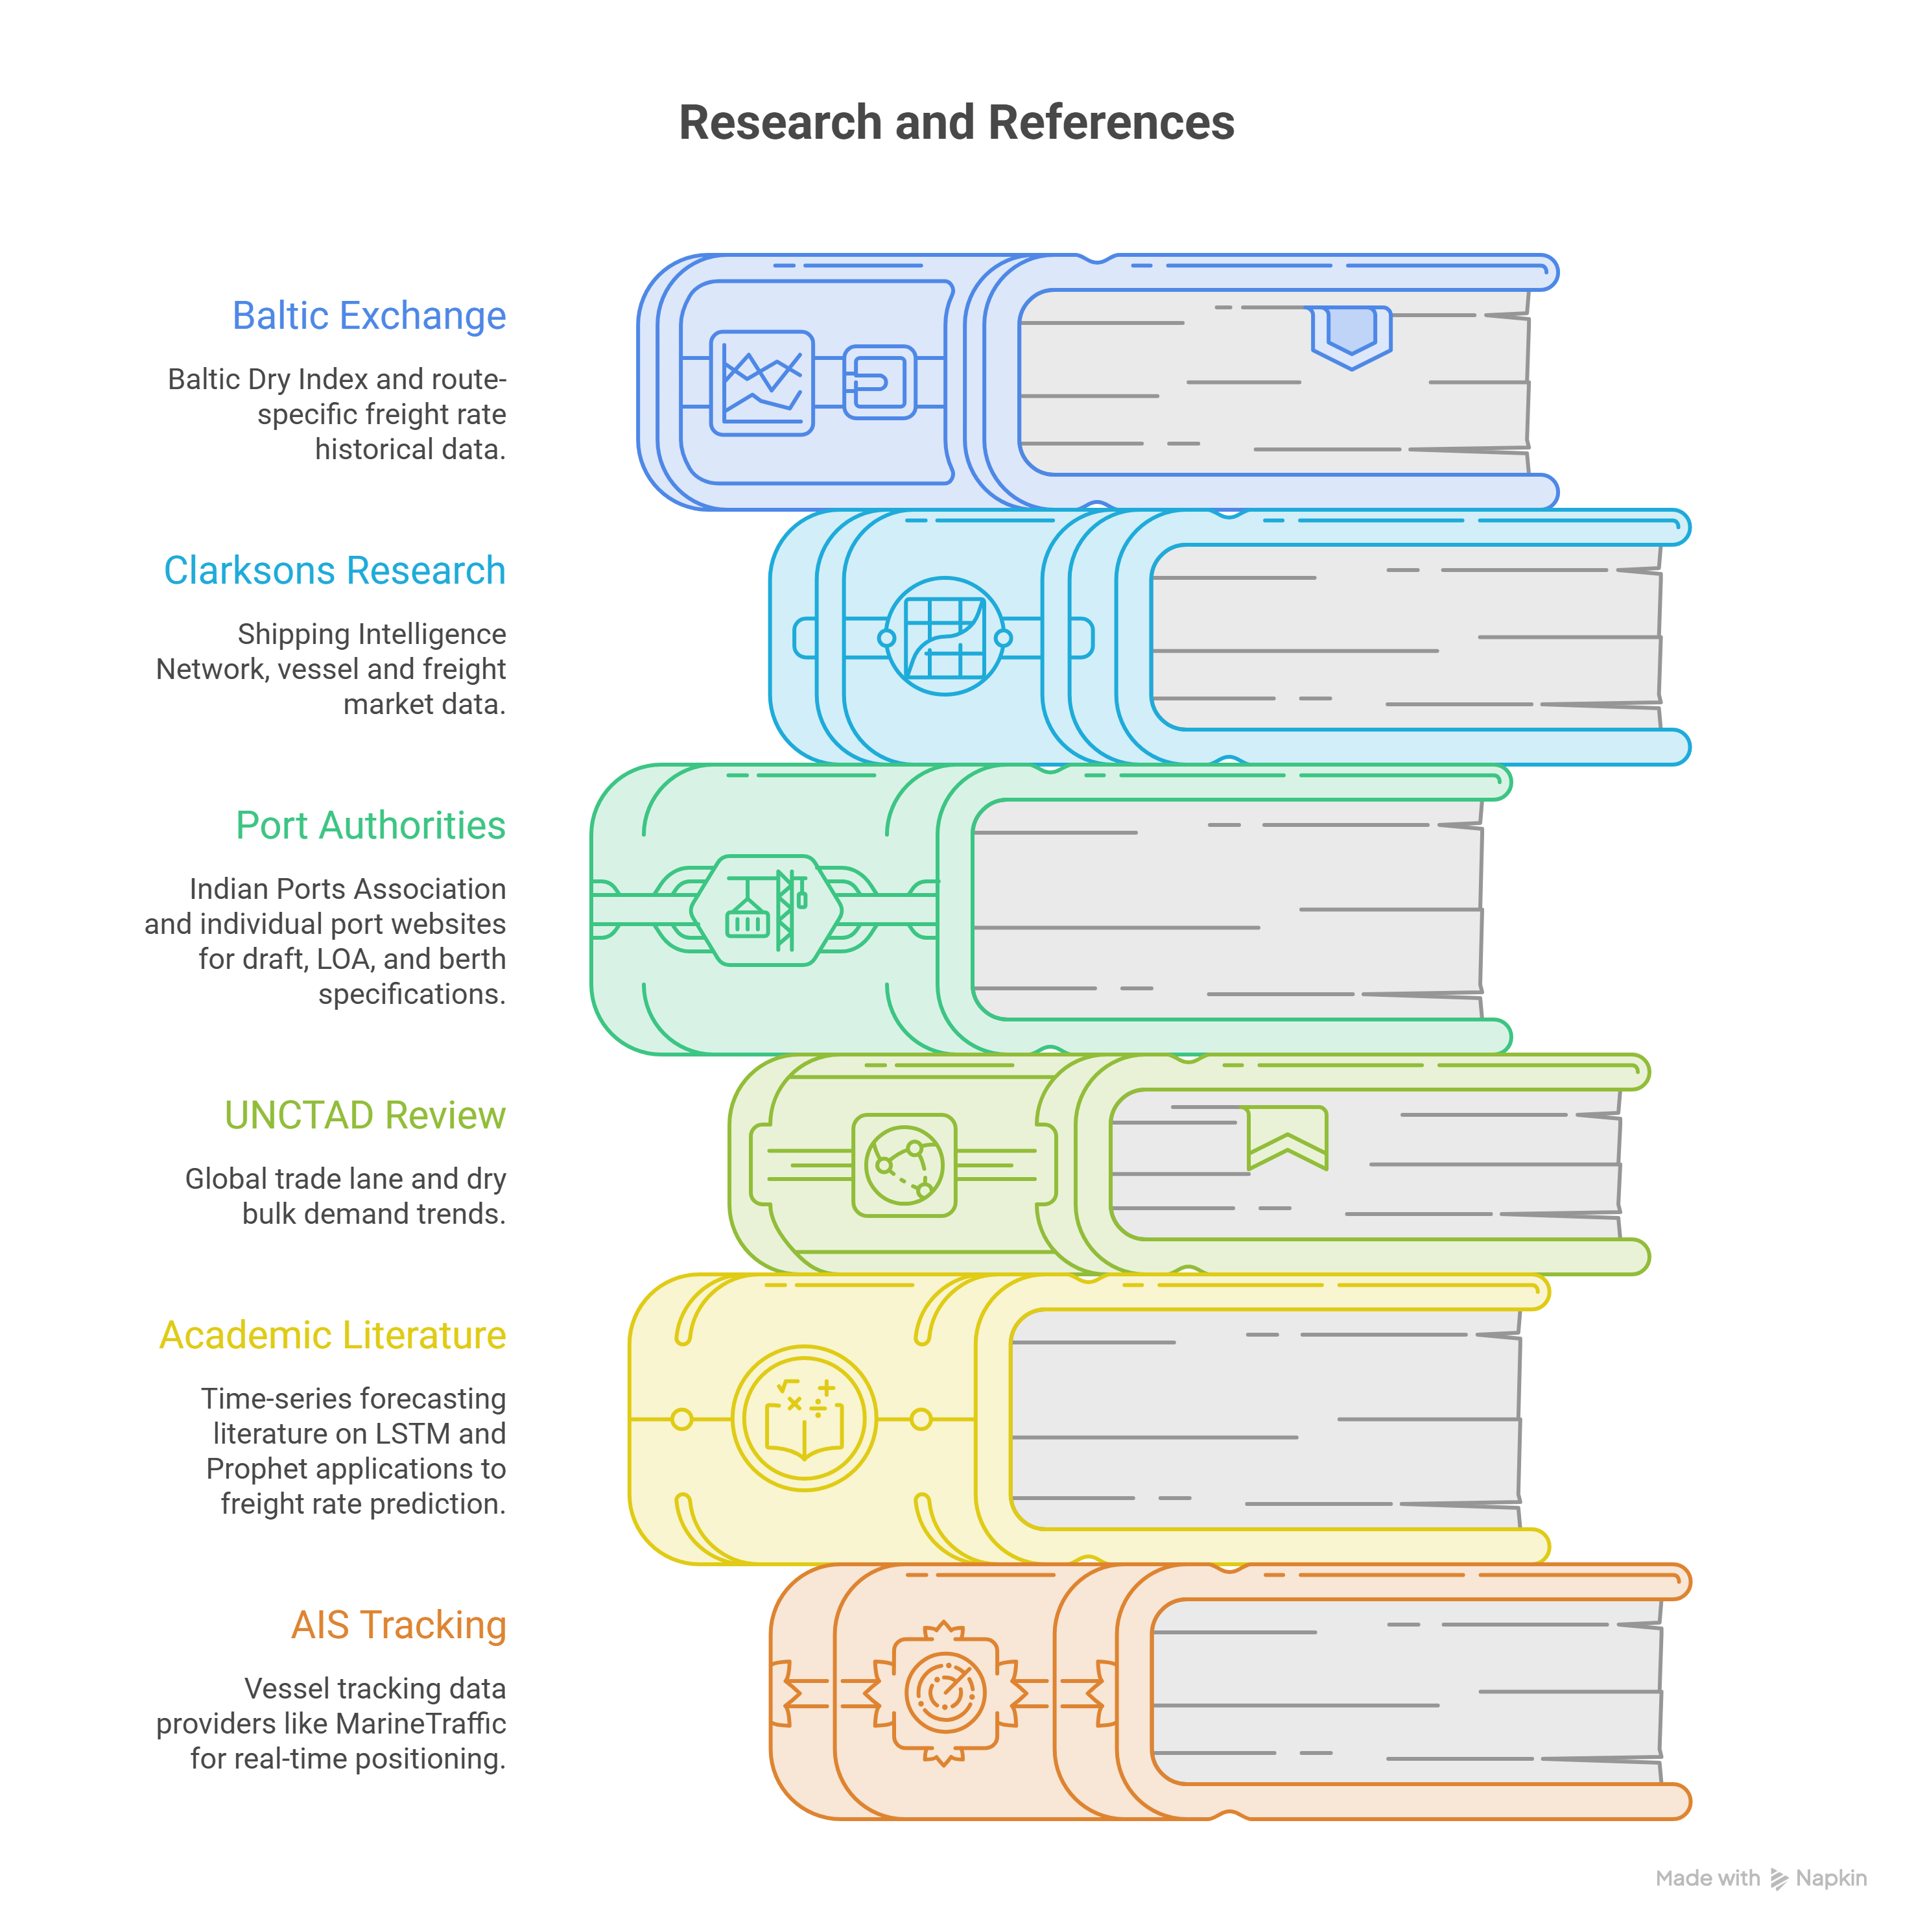
RESEARCH AND REFERENCES
CargoNex
@SIH Idea submission- Template
6
Notes:
6

